Slide 1
ECE 471/571 – Lecture 2
Bayesian Decision Theory
08/22/14

Slide 2
Different Approaches - More Detail
Pattern Classification
Statistical Approach
Syntactic Approach
Supervised
Unsupervised
Basic concepts:
Baysian decision rule
(MPP, LR, Discri.)
Basic concepts:
Distance
Agglomerative method
Parametric learning (ML, BL)
k-means
Non-Parametric learning (kNN)
Winner-take-all
NN (Perceptron, BP)
Kohonen maps
Dimensionality Reduction
Fisher’s linear discriminant
K-L transform (PCA)
Performance Evaluation
ROC curve
TP, TN, FN, FP
Stochastic Methods
local optimization (GD)
global optimization (SA, GA)
ECE471/571, Hairong Qi

Slide 3
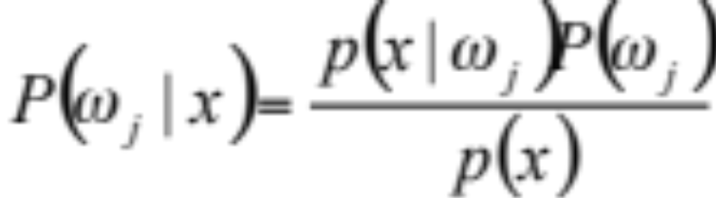
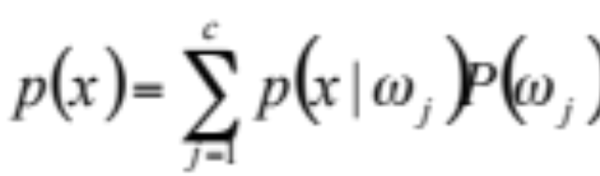
Bayes formula (Bayes rule)
From domain knowledge
a-priori probability
(prior probability)
Conditional probability density
(pdf – probability density function)
(likelihood)
a-posteriori probability
(posterior probability)
normalization constant
(evidence)

Slide 4
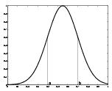
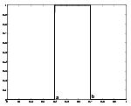
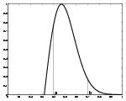
pdf examples
Gaussian distribution
  Bell curve
  Normal distribution
Uniform distribution
Rayleigh distribution

Slide 5
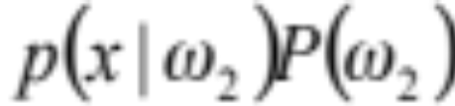
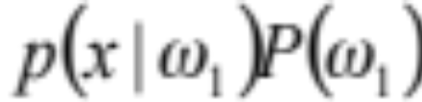
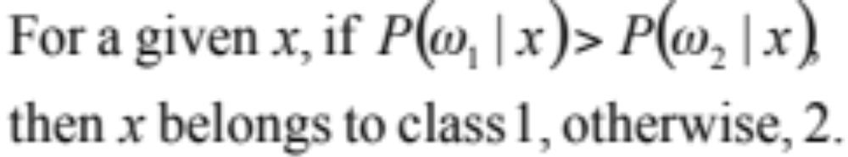
Bayes decision rule
x
Maximum a-posteriori Probability (MAP):
Notes:
Stock market

Slide 6
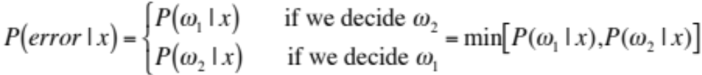
Conditional probability of error

Slide 7
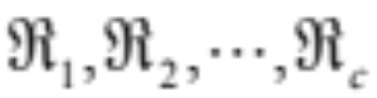

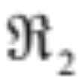
Decision regions
The effect of any decision rule is to partition the feature space into c decision regions

Slide 8

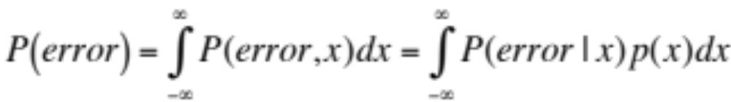
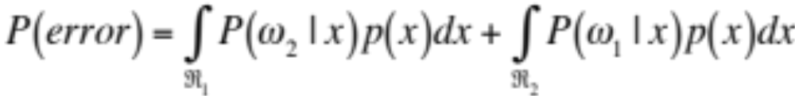
Overall probability of error
Or unconditional risk, unconditional probability of error

Slide 9
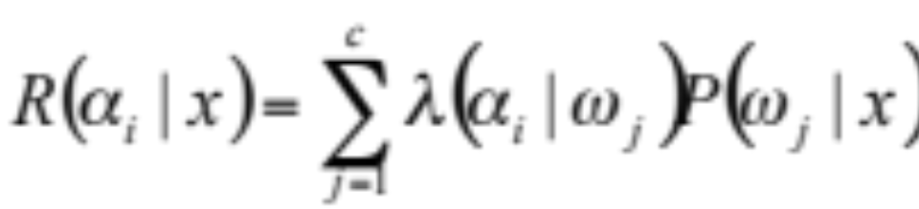
The conditional risk
Given x, the conditional risk of taking action α_{i} is:
λ_{ij} is the loss when decide x belongs to class i while it should be j
λ_{ij}

Slide 10
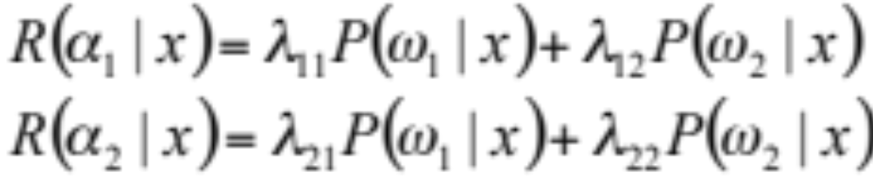
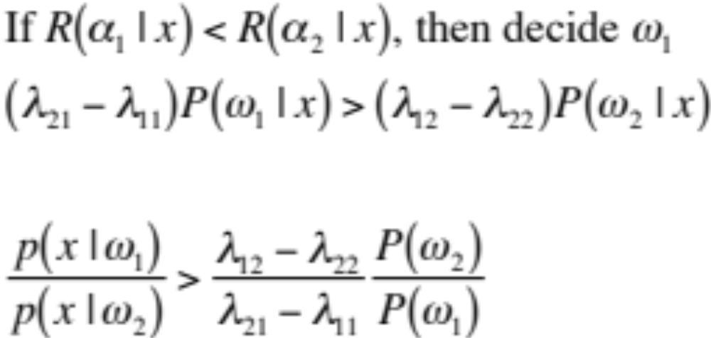
Likelihood ratio - two category classification
Likelihood ratio

Slide 11
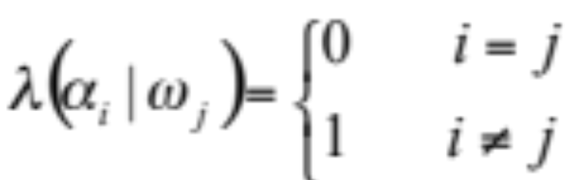
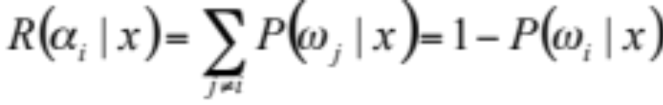
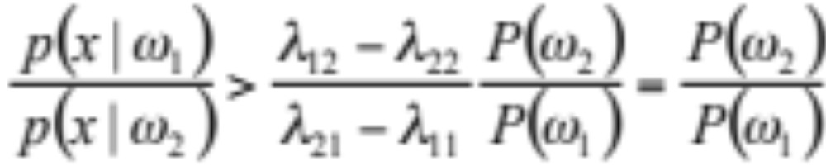
Zero-One loss

Slide 12
Recap
Bayes decision rule → maximum a-posteriori probability
Conditional risk → likelihood ratio
Decision regions → How to calculate the overall probability of error

Slide 13
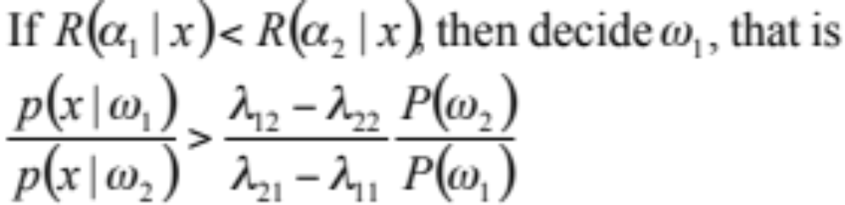
Recap
Maximum
a-posteriori
Probability
Likelihood ratio
Overall probability of error

